Slide 1


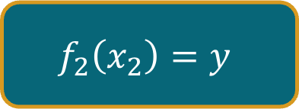
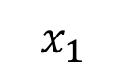
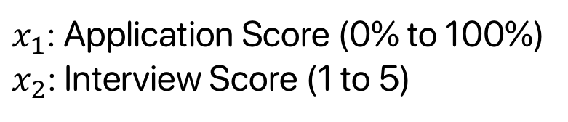
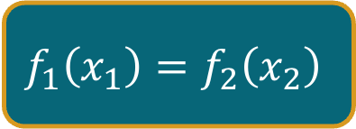
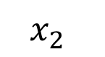
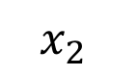
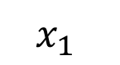
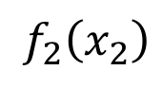
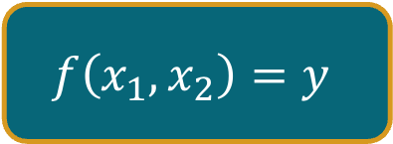

$x_{1}$: Application Score (0% to 100%)
$x_{2}$: Interview Score (1 to 5)
HR + Interview Team
$$x_{1}$$
$$f\left(x_{1}, x_{2}\right)=y$$
Final Decision $y$
Process $x_{1},x_{2}$ in parallel
to save time
$$x_{2}$$
HR
Interview Team
$$x_{1}$$
$$f_{1}\left(x_{1}\right)=f_{2}\left(x_{2}\right)$$
$$f_{2}\left(x_{2}\right)$$
$$f_{2}\left(x_{2}\right)=y$$
Final Decision $y$
$$x_{2}$$

Slide 2
$x_{1}$: Application Score (0% to 100%)
$x_{2}$: Interview Score (1 to 5)
HR + Interview Team
$$x_{1}$$
$$f\left(x_{1}, x_{2}\right)=y$$
Final Decision $y$
Application Score Cutoff = 70%
$$x_{2}$$
HR
Interview Team
$$x_{1}$$
$$f_{1}\left(x_{1}\right)=f_{2}\left(x_{2}\right)$$
$$f_{2}\left(x_{2}\right)$$
$$f_{2}\left(x_{2}\right)=y$$
Final Decision $y$
$$x_{2}$$

Slide 3
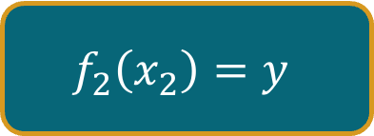
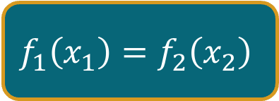
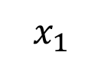
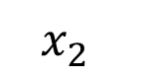
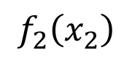
$x_{1}$: Application Score (0% to 100%)
$x_{2}$: Interview Score (1 to 5)
HR + Interview Team
$$x_{1}$$
$$f\left(x_{1}, x_{2}\right)=y$$
Final Decision $y$
$$x_{2}$$
↑ equivalent ↓
HR
Interview Team
$$x_{1}$$
$$f_{1}\left(x_{1}\right)=f_{2}\left(x_{2}\right)$$
$$f_{2}\left(x_{2}\right)$$
$$f_{2}\left(x_{2}\right)=y$$
Final Decision $y$
$$x_{2}$$

Slide 4
Wastes Resources
$x_{1}$: Application Score (0% to 100%)
$x_{2}$: Interview Score (1 to 5)
HR + Interview Team
$$x_{1}$$
$$f\left(x_{1}, x_{2}\right)=y$$
Final Decision $y$
Everyone is interviewed regardless of whether they pass the application score test!
$$x_{2}$$
Wastes Resources
HR
Interview Team
$$x_{1}$$
$$f_{1}\left(x_{1}\right)=f_{2}\left(x_{2}\right)$$
$$f_{2}\left(x_{2}\right)$$
$$f_{2}\left(x_{2}\right)=y$$
Final Decision $y$
$$x_{2}$$

Slide 5
$x_{1}$: Application Score (0% to 100%)
$x_{2}$: Interview Score (1 to 5)
HR + Interview Team
$$x_{1}$$
$$f\left(x_{1}, x_{2}\right)=y$$
Final Decision $y$
$$x_{2}$$
Let’s chain them instead
HR
Interview Team
$$x_{1}$$
$$f_{1}\left(x_{1}\right)=f_{2}\left(x_{2}\right)$$
$$f_{2}\left(x_{2}\right)$$
$$f_{2}\left(x_{2}\right)=y$$
Final Decision $y$
$$x_{2}$$

Slide 6
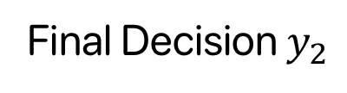
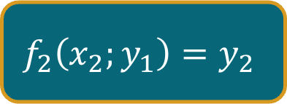
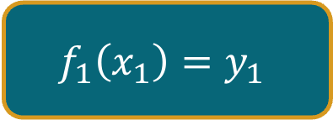
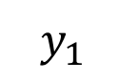
$x_{1}$: Application Score (0% to 100%)
$x_{2}$: Interview Score (1 to 5)
HR + Interview Team
$$x_{1}$$
$$f\left(x_{1}, x_{2}\right)=y$$
Final Decision $y$
$$x_{2}$$
HR
Interview Team
$$x_{1}$$
$$f_{1}\left(x_{1}\right)=y_{1}$$
$$y_{1}$$
$$f_{2}\left(x_{2};y_{1}\right)=y_{2}$$
Final Decision $y_{2}$
$$x_{2}$$

Slide 7
$x_{1}$: Application Score (0% to 100%)
$x_{2}$: Interview Score (1 to 5)
HR + Interview Team
$$x_{1}$$
$$f\left(x_{1}, x_{2}\right)=y$$
Final Decision $y$
$$x_{2}$$
Wastes Time
HR
Interview Team
$$x_{1}$$
$$f_{1}\left(x_{1}\right)=y_{1}$$
$$y_{1}$$
$$f_{2}\left(x_{2};y_{1}\right)=y_{2}$$
Final Decision $y_{2}$
$$x_{2}$$

Slide 8

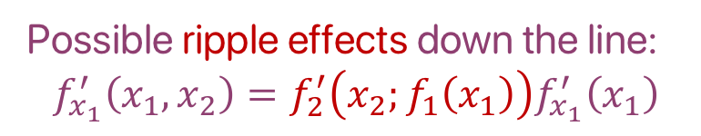


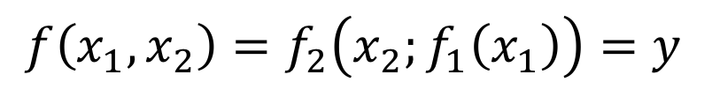
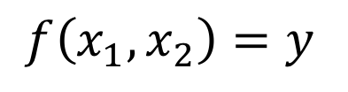
$$f\left(x_{1}, x_{2}\right)=y$$
Processes $x_{1},x_{2}$ in parallel to save time, but takes more resources
No ripple effects down the line—all changes to output are contained:
$$f_{x_{1}}^{′}\left(x_{1},x_{2}\right)$$
$$f\left(x_{1},x_{2}\right)=f_{2}\left(x_{2};f_{1}\left(x_{1}\right)\right)=y$$
Processes $x_{1},x_{2}$ sequentially to save resources, but takes more time
Possible ripple effects down the line:
$$f_{x_{1}}^{′}\left(x_{1},x_{2}\right)=f_{2}^{′}\left(x_{2};f_{1}\left(x_{1}\right)\right)f_{x_{1}}^{′}\left(x_{1}\right)$$

